Slide 1
Capstone Project
Selection of Borough, Neighborhoods, and venues to visit in the City of New York
30/07/202

Slide 2






Presentation Outline
Selection of Borough, Neighborhoods, and venues to visit in the City of New York
Conclusion
Introduction
Methodology
Data
Results & Discussion
The end

Slide 3
Introduction

Slide 4

Problem
Touring a big city such as the New York City in the United States of America is definitely a must do for any tourist visiting the state from abroad
Tourists on a limited time vacation, this can be a little bit stressful given how huge the city is, and the relatively little time to have to make the most out of this experience
Objectives
In this project, we will mainly assist a hypothetical tourist trying to effectively select the best places to visit given the little time they have.
This will save the extensive research and decision-making time especially for indecisive tourists!

Slide 5
Data

Slide 6
Data Background
The project extensively relies on the dataset of the New York City made available by the course instructor in the labs (Week 3 of the capstone project course).
The Data is first obtained as a JSON file that was later loaded and read into a Pandas Dataframe.
Critical data about the venues in each neighborhood in the NYC will be retrieved from the FourSquare API.
The acquired data will be manipulated via exploratory data analysis tools such as pandas library tools, and will be visualized using matplotlib (for plots) and folium (for maps).
The data is to be cleaned and filtered to acquire only the necessary information and then used and manipulated for a clear data analysis.
This of course will necessitate importing the necessary libraries and dependencies which will be elaborated in the methodology section of this report.
Data Content
Borough
Neighborhoods
Neighborhoods Coordinates
Venues
Venues Categories
Venues Coordinates
Other

Slide 7
Methodology

Slide 8

Methodology
A 6-Step Approach
1
Importing Libraries
6
Machine Learning Model
4
Exploring the city
3
Generating the map of New York
3Retrieving the necessary NYC dataS
Data visualization
5
2

Slide 9
Results & Discussion

Slide 10
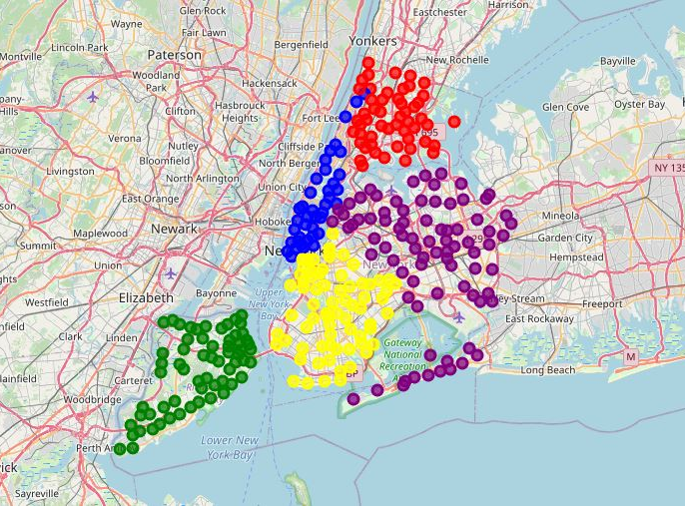
The neighborhoods of the 5 Boroughs were given different colors
This will aid in understanding the NYC neighborhood data

Slide 11
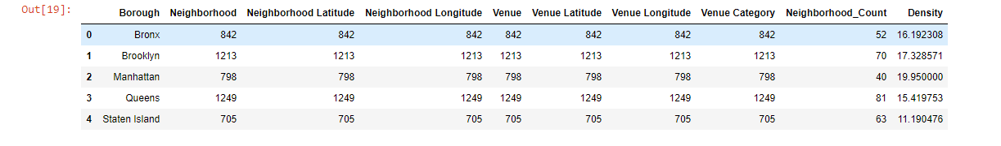
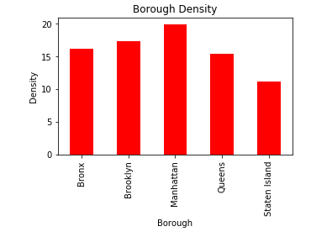
Manhattan had the highest venue density among the 5 Boroughs
This means that this borough is more condensed in venues, and that’s an indicator of a rich touristic experience.
But density is not the only factor to take into account.

Slide 12
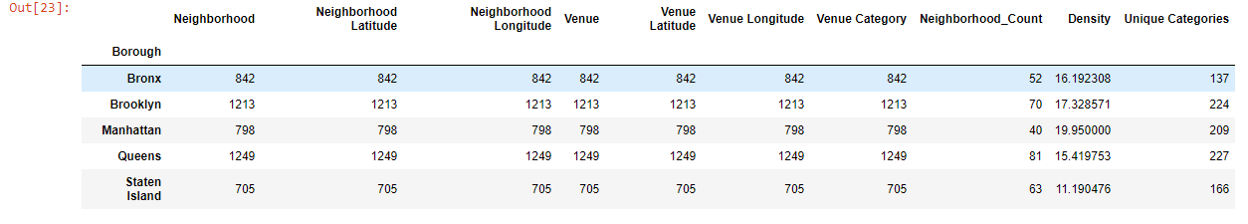
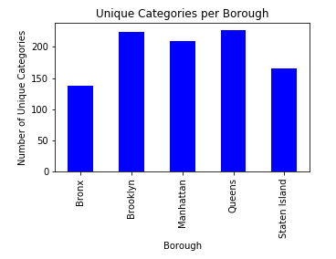
Queens had the highest number of distinct venue category, which indicates it is the most diverse among the 5 boroughs, which is also an indicator of a rich touristic experience

Slide 13
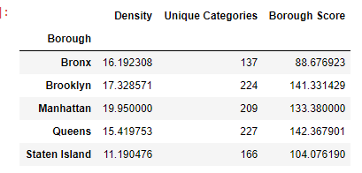
Borough Score = 60% Unique Category + 40% Density
Queens has the highest score, and that is our borough selection

Slide 14
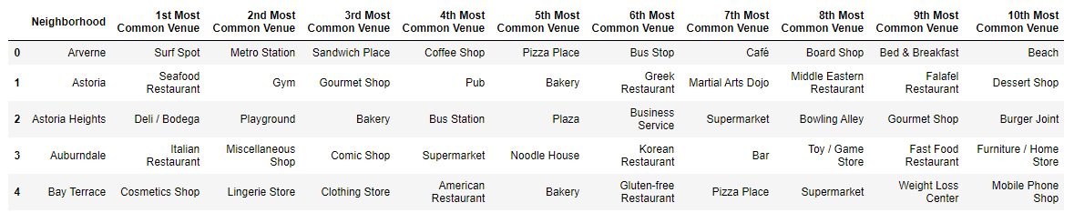
The 10 most common Venues in each Neighborhood were determined. This will aid our tourist in selecting the neighborhoods to visit

Slide 15
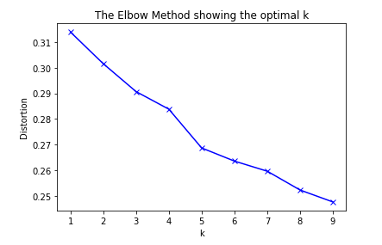
The optimal number of clusters was determined to divide the neighborhoods in Queens into clusters based on their venue similarities

Slide 16
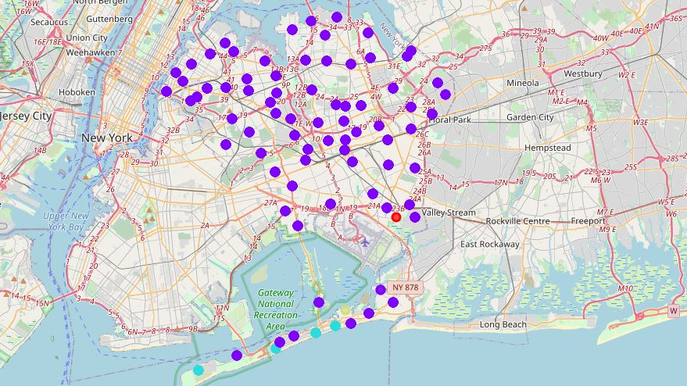
This shows that most of Queens Neighborhoods are similar and fall under 1 cluster
We can see that this is beneficial to our tourist, as they can select neighborhoods randomly from the biggest cluster, without the fear of missing out on anything

Slide 17
Main Outcomes
Queens is the best Borough to visit first.
Most of Queens Neighborhoods are similar and fall under 1 cluster.
We can see that this is beneficial to our tourist, as they can select neighborhoods randomly from the biggest cluster, without the fear of missing out on anything.
They can also visit the remaining clusters, perhaps all of them, given that they’re unique, and therefore intriguing to the tourist.
Of course, they can build their decision on the 10 most common places in each neighborhood we discussed earlier.

Slide 18
Conclusion

Slide 19
Conclusion
In this project, we guided our tourist in selecting the places to visit during his tour in the City of New York.
The results of our analysis should help the tourist selecting the best borough, neighborhoods and venues to visit, and should make his decision-making process an easy and clear process.
Data science techniques were used to reach the above results and extract the hidden insights behind the provided datasets.

Slide 20
Thanks for Watching
the presentation

